Slide 1
Twitter A/B Testing: Overspending Analysis
By Vishal Gir Goswami

Slide 2
Problem Statement
• Twitter ads use a click-based billing model
• Overspending issue due to delayed click reporting
• New impression-based model introduced to reduce overspend

Slide 3

Experiment Design
• A/B Test setup:
- Control group → Click-based billing
- Treatment group → Impression-based billing
• Duration: 1 week
• Goal: Evaluate overspending reduction

Slide 4
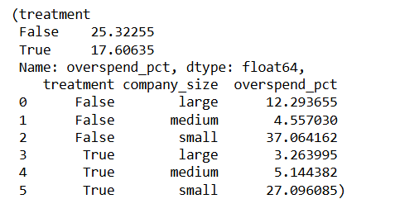
Campaign Overspend (>1%)
• Control group: 5,716 campaigns
• Treatment group: 5,180 campaigns
✅ New model reduced overspending campaigns

Slide 5
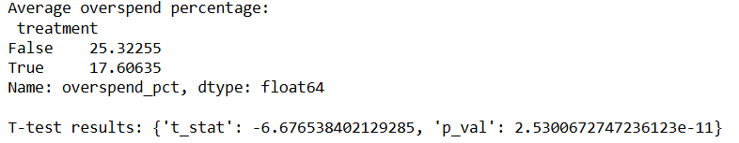
Average Overspend Comparison
• Control (old model): 25.32%
• Treatment (new model): 17.61%
• Reduction: 7.71 percentage points
✅ Statistically significant (p ≈ 0.00002)

Slide 6
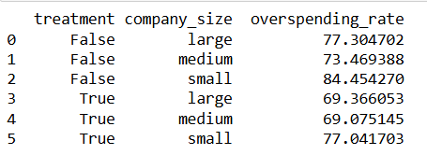
Overspend by Company Size
Large: 12.29% → 3.26% (Improved by -9.03%) ✅
Medium: 4.56% → 5.14% (Worsened by +0.58%) ❌
Small: 37.06% → 27.10% (Improved by -9.96%) ✅

Slide 7
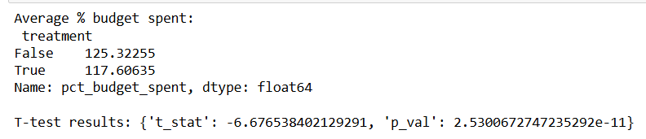
Budget Concerns
• Control avg. budget: $4,642
• Treatment avg. budget: $6,902
• p-value: 0.156 (Not statistically significant)
❌ No evidence advertisers lowered budgets

Slide 8

Other Analyses & Data Gaps
• CTR & Engagement metrics → Not available in dataset
• Suggested: Include impressions, clicks, likes, retweets, replies for future analysis

Slide 9
Statistical Tests Conducted
• T-tests → Overspend difference is significant
• ANOVA → Company size affects overspend rates
• Variance tests → Campaign spend variance differs between groups

Slide 10
Key Takeaways
• Impression-based model reduces overspend
• Works best for large & small companies, not medium
• No evidence of advertisers lowering budgets
• Future analysis should add CTR & engagement data

Slide 11
Recommendations
• Roll out new model for large & small advertisers first
• Investigate why medium companies see worse results
• Collect engagement metrics for deeper analysis

Slide 12
Conclusion
The A/B test clearly demonstrates that Twitter’s new impression-based billing model is effective in reducing campaign overspending. Overspend decreased by an average of 7.7 percentage points, a statistically significant improvement. Both large and small advertisers benefited significantly, while medium-sized advertisers saw slightly worse results, suggesting the need for further optimization.
Importantly, there is no evidence that advertisers in the treatment group lowered their budgets due to the new product.
Overall, the new model is a strong candidate for rollout, with adjustments needed to better serve medium-sized companies. Future experiments should also incorporate CTR and engagement metrics to provide a complete picture of effectiveness.

Slide 13
Thank You

